Slide 1
Building Simulation Models in R
Will Yuill
Public Health, Hertfordshire County Council & JBS/JEIC/OHID Modelling Fellow
Will.Yuill@hertfordshire.gov.uk
Simulation Models in R | 2022-11 | PH.Intelligence@hertfordshire.gov.uk

Slide 2
Simulation Modelling
“[Simulation Modelling is] an external and explicit representation of part of reality as seen by the people who wish to use that model to understand, to change, to manage and to control that part of reality.” (Pidd, 1996)
“You cannot meddle with one part of a complex system from the outside without the almost certain risk of setting off disastrous events that you hadn’t counted on in other remote parts. If you want to fix something you are obliged to first understand … the whole system.” (Thomas, 1974)
Simulation Models in R | 2022-11 | PH.Intelligence@hertfordshire.gov.uk

Slide 3
Types of Simulation Modelling
 | Discrete Event Simulation | System Dynamics
Scope | Operational, tactical | Strategic
Importance of variability | High | Low
Importance of tracking individuals | High | Low
Number of entities | Small | Large
Control | Holding (queues) | Rates (flows)
Relative timescale | Short | Long
Purpose | Decisions: optimisation, prediction and comparison | Policy making: gaining understanding
Reproducibility | Stochastic (will vary each run) | Deterministic (usually returns the same results)
Adapted from Brailsforth and Hilton (2001)
Simulation Models in R | 2022-11 | PH.Intelligence@hertfordshire.gov.uk

Slide 4
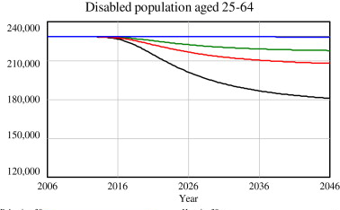
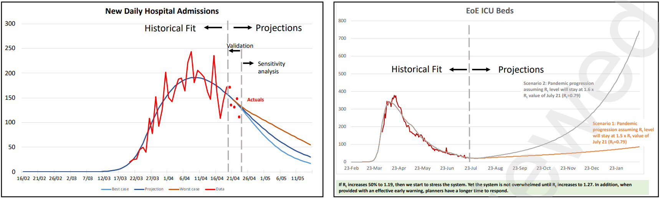
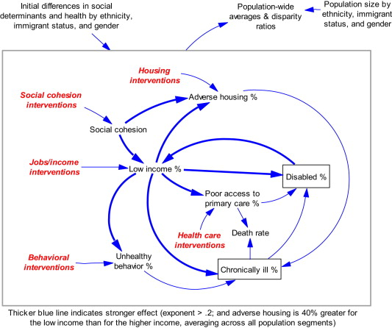
DOI:10.1016/j.socscimed.2012.06.036 / http://dx.doi.org/10.2139/ssrn.3695258
Simulation Models in R | 2022-11 | PH.Intelligence@hertfordshire.gov.uk

Slide 5









Modelling Software
Simulation Models in R | 2022-11 | PH.Intelligence@hertfordshire.gov.uk

Slide 6
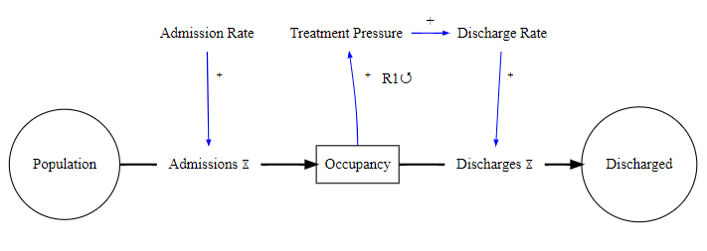
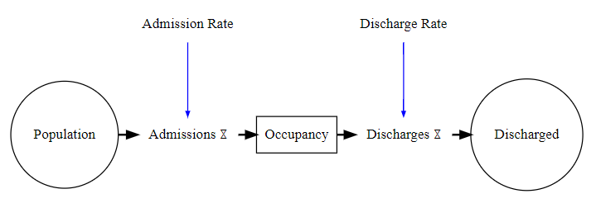
Occupancy Example: Conceptualise
Simulation Models in R | 2022-11 | PH.Intelligence@hertfordshire.gov.uk

Slide 7
Occupancy Example: Model
simtime <- seq(1, 365, by = 0.125); stocks <- c(s_Occupancy = 100); aux <- c(a_DischargeRate = 0.06, a_Capacity = 80)
model <- function(sim_time, stocks, auxs){
with(as.list(c(stocks, auxs)), {
a_Pressure <- s_Occupancy / a_Capacity # Aux – get effect of being over/under capacity
f_Admissions <- sample(1:10, 1) # Flow - number of new patients admitted at each time step
f_Discharges <- s_Occupancy * (a_DischargeRate * a_Pressure) # Flow - discharge rate based on occupancy/pressure
d_sOccupancy_dt <- f_Admissions – f_Discharges # Integral of stock - change in occupancy stock
return(list(c(d_sOccupancy_dt), Admissions = f_Admissions, Discharges = f_Discharges,
DischargeRate = a_DischargeRate, Pressure = a_Pressure)) # Return results for the timestep
})
}
data.frame(deSolve::ode(y = stocks, times = simtime, func = model, parms = aux, method = "euler")) # Run model
Simulation Models in R | 2022-11 | PH.Intelligence@hertfordshire.gov.uk

Slide 8
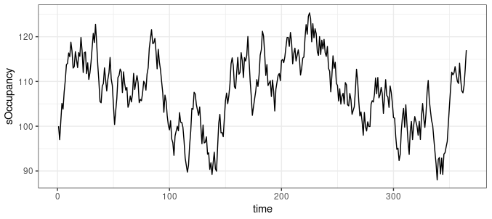
Occupancy Example: Output
Simulation Models in R | 2022-11 | PH.Intelligence@hertfordshire.gov.uk

Slide 9
Further Information

Slide 10
Components
Stocks & Flows
These are the building blocks of SD models. Stocks represent the quantity of an item at a given time (e.g. patients on a ward, calls waiting) whilst flows are a measure of the input/output between stocks.
Feedback Loops
Circular casual links allow one part of a system to influence another, for instance when a ward is full the flow of admissions decreases until the ward has capacity whereupon the flow will increase again.
Auxiliary variables
These are often used as a way to simply models – rather than modelling everything associated with admission rate we may just assume admission rate as a certain value.
Simulation Models in R | 2022-11 | PH.Intelligence@hertfordshire.gov.uk

Slide 11
Modelling Changing Systems
Continuous Change
Forcing functions can be used to model the impact of continuous changes such as seasonality. This uses the approxfun function in base R.
Abrupt Change
Events can be used to model the impact of abrupt changes such as policy changes, stocks becoming full, or to add external inputs. These can be added through a dataframe or when the model reaches a threshold.
Delays
Allows a lag between arriving in one stock and arriving at the next (e.g. an infectious period). This can be modelled as `flow <- s_infected / delay` (remember step size must be smaller than the length of delay).
Simulation Models in R | 2022-11 | PH.Intelligence@hertfordshire.gov.uk

Slide 12
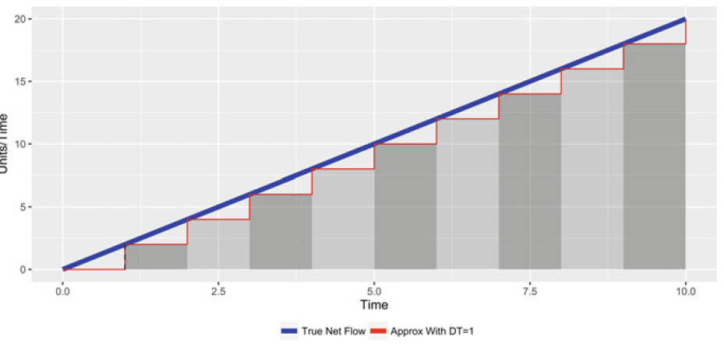
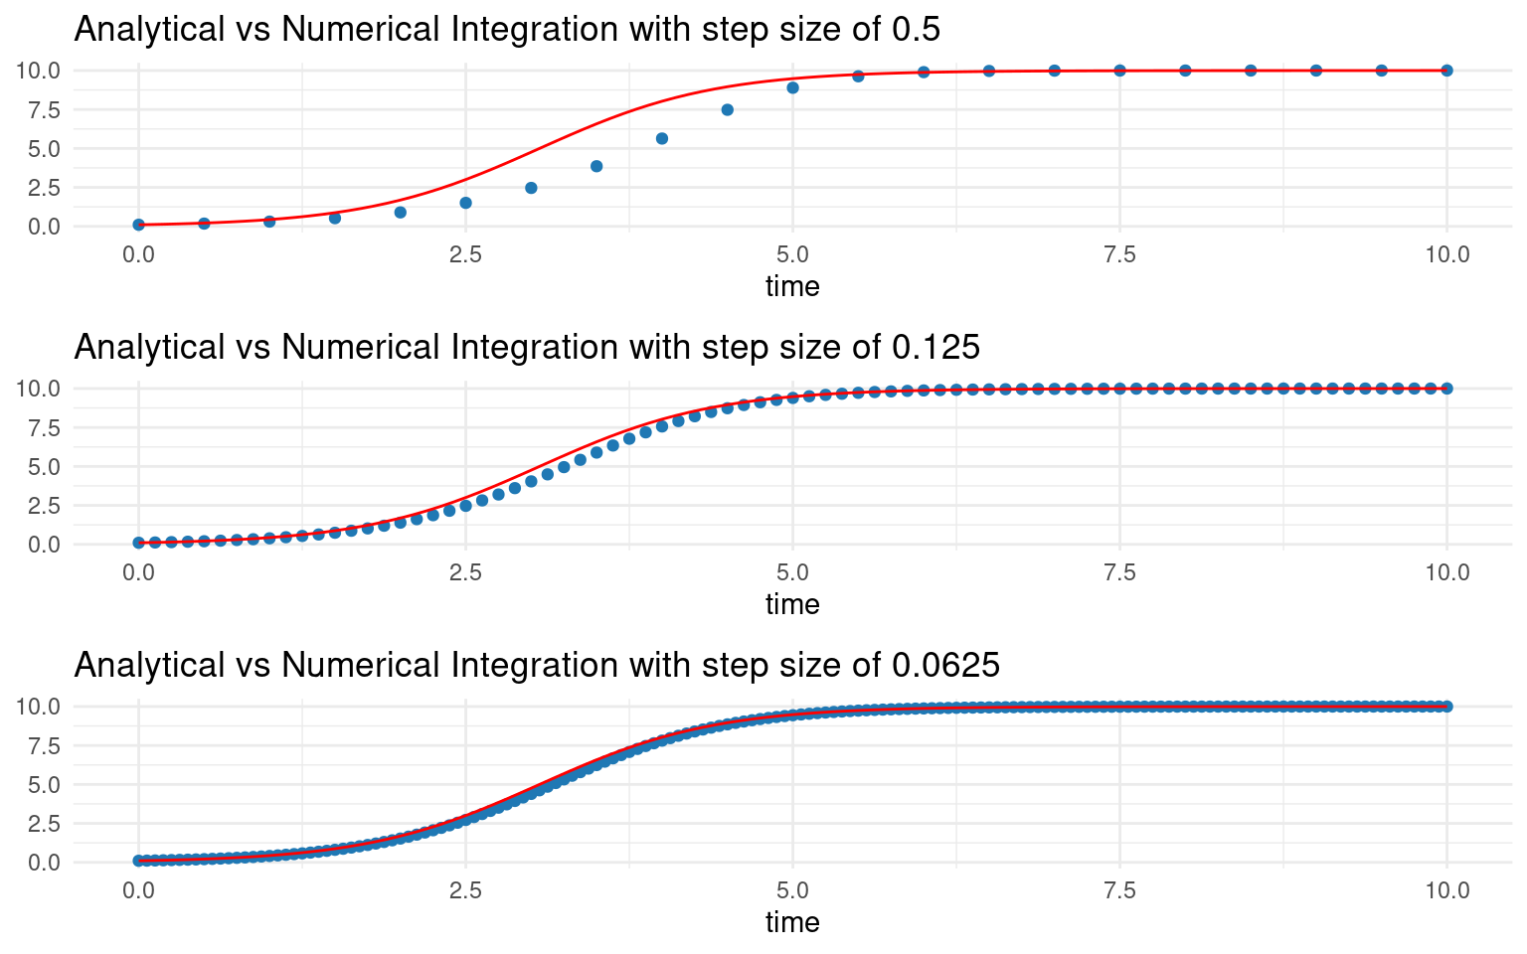
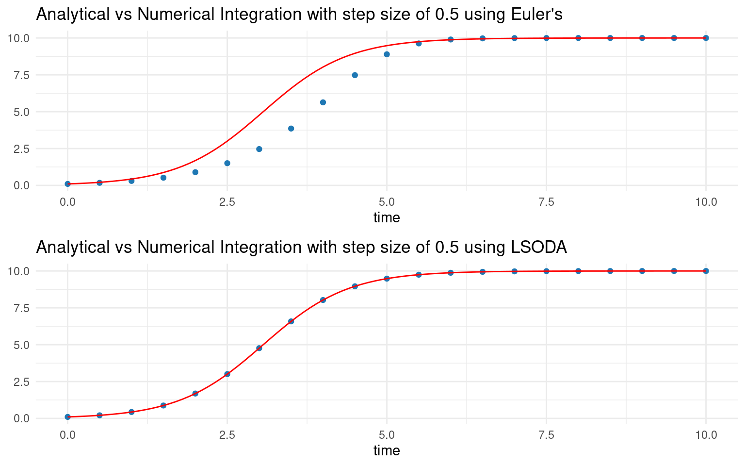
Integration
*
True Net Flow
Approx. Net Flow with Step Size = 1
Integration is the process by which SD models estimate flow.
Step sizes must be no greater than the shortest event time and should be fractions or multiply to 1 (0.125/ 0.0625 are recommended).
The Euler solver is commonly used in SD models, with Runge-Kutta used where high accuracy is important (deSolve defaults to LSODA).
Simulation Models in R | 2022-11 | PH.Intelligence@hertfordshire.gov.uk
*Adapted from J. Duggan. (2016) System Dynamics Modeling with R.

Slide 13
Bringing in the rest of R
Testing can be done using the testthat package 🎉
Calibration can be done using the FME package
DiagrammeR can be used to produce diagrams of the model
pysd2r can be used to read and run Vensim models in R
readsdr can be used to read and run Stella models in R
shiny can be used to create an interactive model that end users can run
Simulation Models in R | 2022-11 | PH.Intelligence@hertfordshire.gov.uk

Slide 14
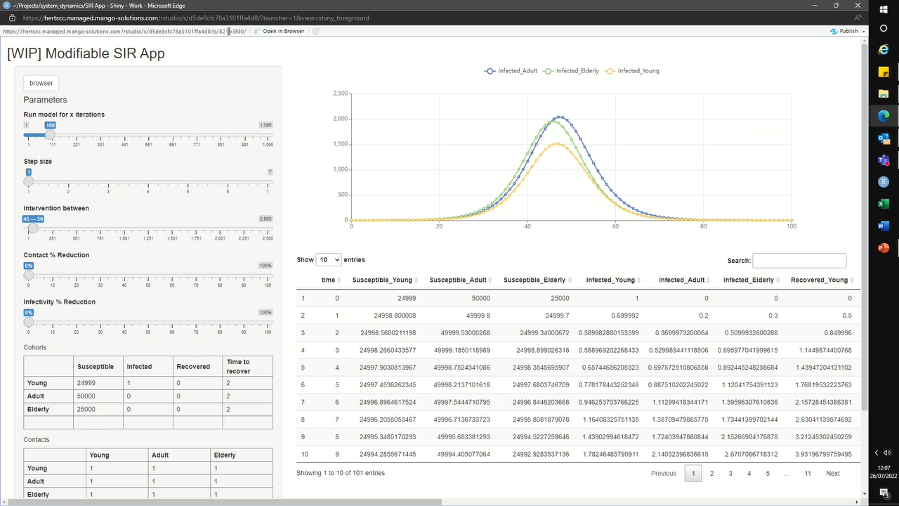
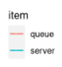
Shiny
Simulation Models in R | 2022-11 | PH.Intelligence@hertfordshire.gov.uk

Slide 15
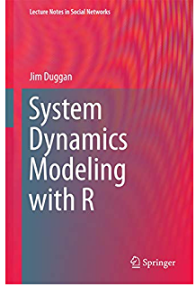
Further Reading & Examples
J. Duggan. (2016) System Dynamics Modeling with R (and https://github.com/JimDuggan/SDMR)
Our GitHub repo (https://github.com/herts-phei/Simulation_Modelling)
Strategy Unit Mental Health Surge Model (https://github.com/The-Strategy-Unit/723_mh_covid_surge_modelling)
Simulation Models in R | 2022-11 | PH.Intelligence@hertfordshire.gov.uk

